Slide 1


Slide 2
Welcome to the Poker AI Workshop!

Slide 3
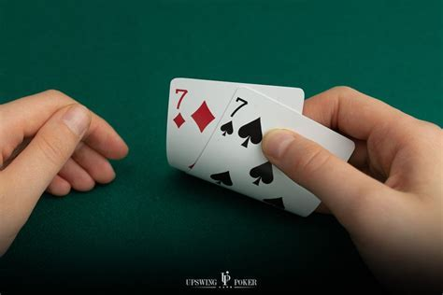
Poker Terminology
A hand: Cards dealt to a player (hidden information)
A board: community cards that are dealt face up. In no limit holdem, these consist of a flop (3 cards), turn (1 card), river (1 card).
SB/BB: Money put in by both players originally in each round (1 and 2). These alternate between rounds.
Showdown: Once no more community cards should be dealt, and all betting action has completed, the player with the better hand wins the pot.
Check: A bet of 0 (passing)
Bet X: Bet X chips. Your opponent can either call the X, raise to Y, or fold.
All In: A bet or raise that wagers all of your remaining chips.

Slide 4
Contents
Basic poker terminology
What to code
All-In bot
A very FLAWED model
Why is this model flawed?
Further directions

Slide 5
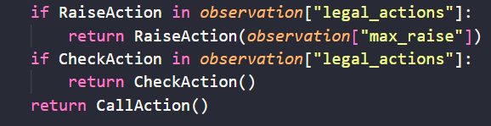
All-In Bot

Slide 6

A benchmark: Optimized All-In Bot
What if you only go all in with the best X% of hands and fold the rest? Or, what if instead of going all-in, you make a big preflop raise instead?
This bot can win money versus bots that call too wide. It can also win money versus bots that call too narrowly.

Slide 7

A VERY FLAWED model (“Prob Bot”)
Calculate Equity (showdown winning probability)
Consider all possible combinations of enemy cards, community cards to count the number of times we win. Equity = win_num / total_num
Calculate pot odds
Use the calculations

Slide 8
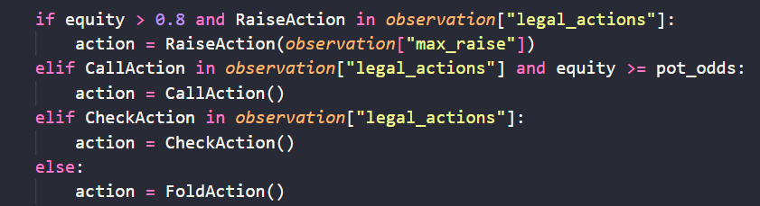
prob_bot Bankroll: 31605
allin_bot Bankroll: -31605

Slide 9
Why is this model FLAWED?
Over-Simplistic Equity Calculation (No attempts to narrow down hand range)
Inflexible Betting Amounts
Ignoring Contextual Information (Bet history, etc)
Lack of Bluffing Strategy
“In conclusion, while the given pseudocode is a basic representation of decision-making in poker, it lacks the sophistication and adaptability required for a robust poker-playing algorithm.”

Slide 10
Utilizing Reinforcement Learning
CFR (Counterfactual Regret Minimization) based methods
Policy Gradients
Genetic Algorithms
And much more…..

Slide 11
Utilizing Heuristic Algorithms (improving Prob Bot)
Evaluate your hand’s Equity: the expected share of the pot your hand is worth. Multiple factors influence a hands equity:
Its current raw strength
Its ability to improve to a stronger hand on certain cards (i.e. flush draws or straight draws in NLH).
Its “blocking effect”: in making very strong hands in the villains range less likely.
The position (the player who is last to act is mathematically known to have an advantage in almost all imperfect information games).
When to bet?
For “value”: your hand has enough equity to want to inflate the size of the pot.
As a “bluff”: your hand will almost certainly lose if you give up and check.
And much more…..

Slide 12
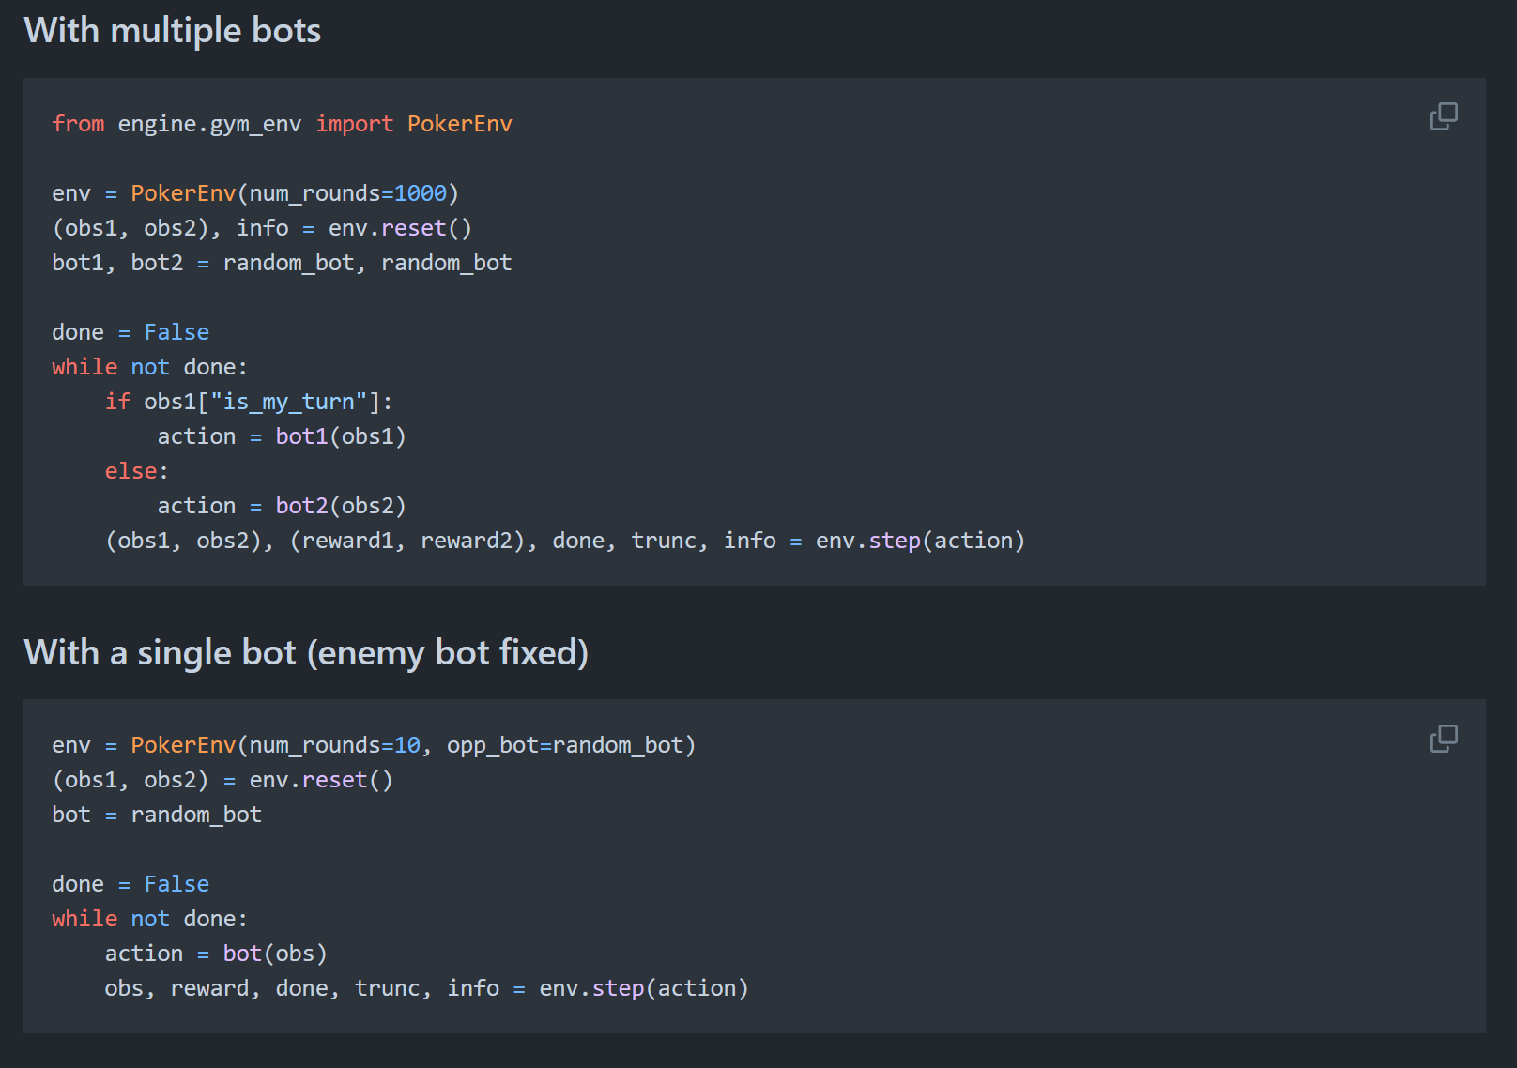

Slide 13
GLHF!

